Slide 1
Behavioural Intervention Program
Using Positive Reinforcement and Prompting to Increase Sharing Behaviour in a 5-Year-Old Boy During Circle Time

Slide 2
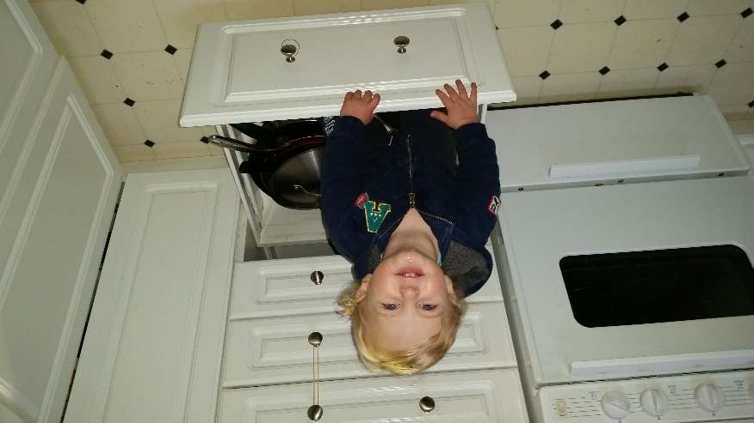
Meet Franky Nannoplay
MAdd your first bullet point here
Add your second bullet point here
Add your third bullet point here

Slide 3
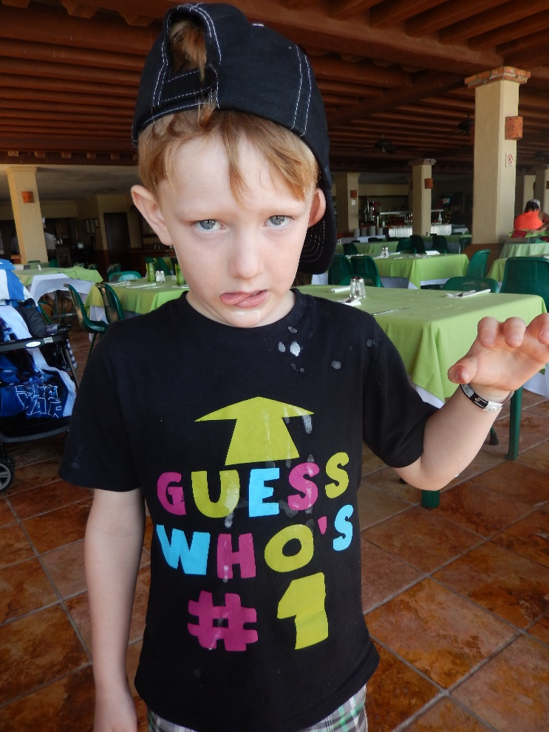
Meet Franky Nannoplay
5-year old
Attends kindergarten at St. Oiler’s Public School
Lives with single father and two sisters
Referred by his teacher for inappropriate play skills
No medical diagnosis
No medication

Slide 4
Target Behaviour – Sharing
Franky’s sharing behaviour is recorded each time he passes an object to another peer when asked or told, or when he does not grab an object from a peer.
Franky is to comply within 5 seconds of his peer asking for the object(s), or his teacher instructing him to share the object(s).
Franky is not to take an object from out of his peer’s hand without first asking to have the object.

Slide 5
Rationale
Step 1 Title
Step 2 Title
Step 3 Title
Step 4 Title
Step 5 Title

Slide 6
Assessment Procedures

Slide 7
Graph

Slide 8
Hypothesis

Slide 9
Research

Slide 10
Goal and Objectives

Slide 11
Intervention Procedures

Slide 12
Intervention Results

Slide 14
Graph

Slide 15
Program Changes & Maintenance and Generalization

Slide 16
Follow-Up

Slide 17
Questions?
Subtitle

